Slide 1
Purpose of Interactive Journal
The INJ is a portfolio for scholarly success.
The purpose of the Interactive Journal is to enable students to be creative, independent thinkers and writers. Interactive notebooks are used for class notes as well as for other activities where the student will be asked to express his/her own ideas and process the information presented in class.

Slide 2
What you will need today…
A composition book
Colored Pencils
Liquid glue or a glue stick or tape
Scissors
Paper Clips
Teacher supplied instructions
Notebook expectations
Right Side/Left Side Template

Slide 3
Setting up interactive journal
Step 1: Count off the last six (6) pages of your INJ. Secure them using a paper clip.
Step 2: Count off the first six (6) pages of your INJ. Secure them with another paper clip.
Step 3: Design your outside cover.

Slide 4
Setting up interactive journal contd.
Inside Cover
Title Page: First Right Side Page
This will be your notebook’s title page.
You may design it any manner you wish as long as it is course related.
Must include the following:
The words “Interactive Journal” (at the top of the page)
Your name
Grade level
English – your class period
Erika M. Pryor, pryore@scsk12.org, Remind code, Web address
This is your creating space. You can design this the way you want.
Use photos, newspaper or magazine clips, markers, color pencils, paint, even glitter. Make it your own.
Feel free to surf the web for ideas, and quotes.
Also, you may work together on this.

Slide 5
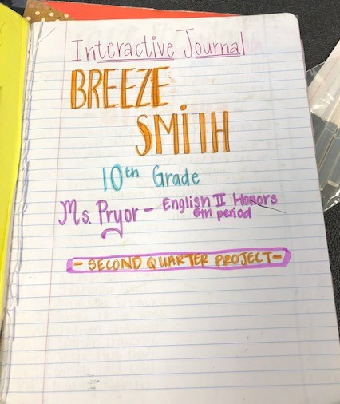
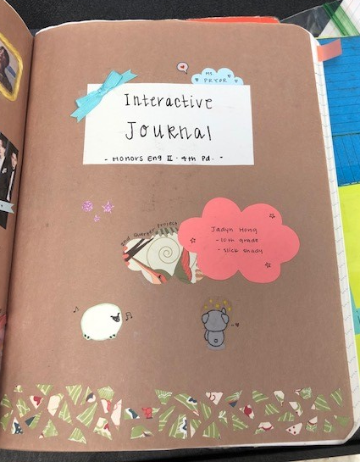
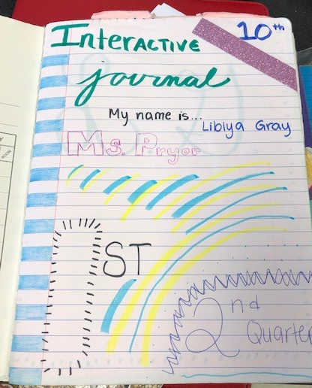
Setting up interactive journal contd. Title page examples
This will be your notebook’s title page.
You may design it any manner you wish as long as it is course related.
Must include the following:
The words “Interactive Journal” (at the top of the page)
Your name
Grade level
English II – your class period
Ms. Erika M. Pryor, pryore@scsk12.org, Remind code, Web address

Slide 6
Setting up interactive journal contd.
Left Side: All About Me Page
Mention the following:
This is a mini biography. Tell me all about who you are, your favorite things, your fondest memories. Tell me about what makes you, you!
You may also include a photo of yourself.
The name you prefer to be called
Birthdate
Favorite Color
Favorite Movie
Your Hobbies
Favorite Books
Favorite Music or Artist
What is the best way to celebrate you and your accomplishments?

Slide 7
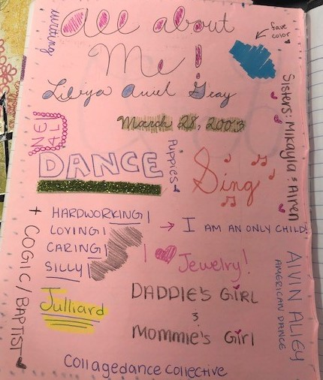
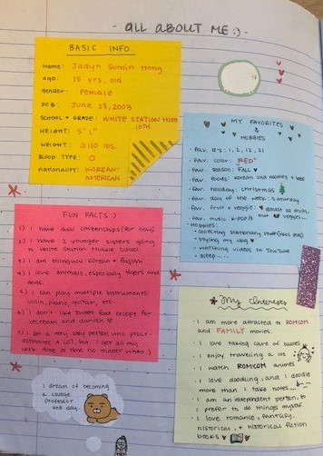
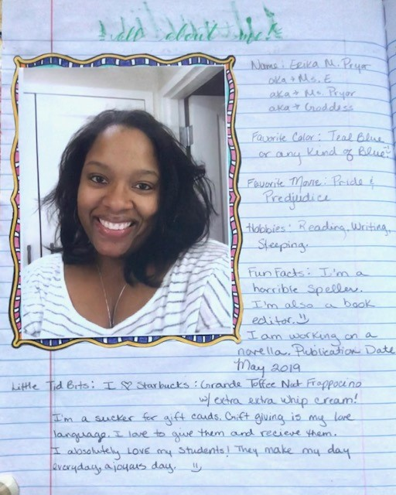
All about me page examples:

Slide 8
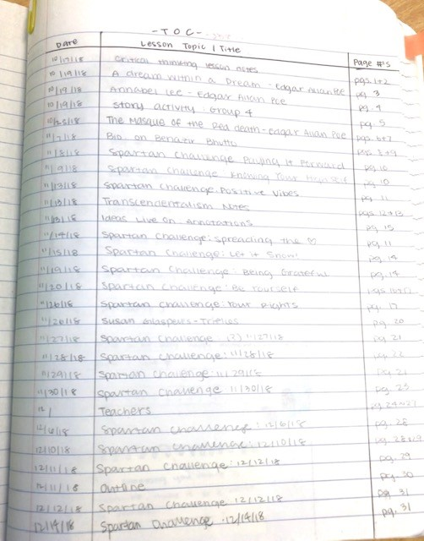
Setting up interactive journal contd. T.O.C
On the top of this page you write: Table of Contents.
Using a ruler measure 1 inch from left margin. Draw a straight line vertically.
At the far right margin, draw a line directly over the pink line.
On the first line and first box write: DATE
In the next box write: Lesson Topic/Title
In the last box write: Page #
Table of Contents: Right Side Page
Example:

Slide 9
Setting up interactive journal contd.
Left Side: Table of Contents – Repeat on the other side of the paper
Right Side: Goals for 2018-2019
On the top of this page you write: Table of Contents.
Using a ruler measure 1 inch from left margin. Draw a straight line vertically.
At the far right margin, draw a line directly over the pink line.
On the first line and first box write: DATE
In the next box write: Lesson Topic/Title
In the last box write: Page #
Create a list of goals you wish to accomplish during this school year.
Examples:
Make straight A’s
Be a better friend
Star in a play
Become an All Star Athlete

Slide 10
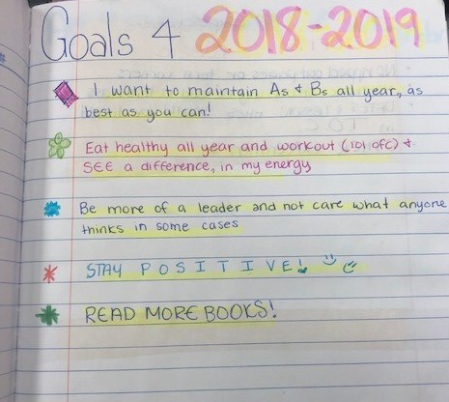
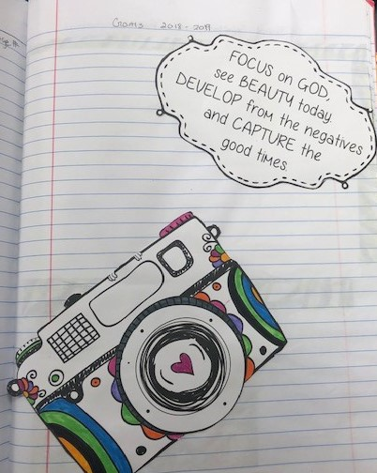
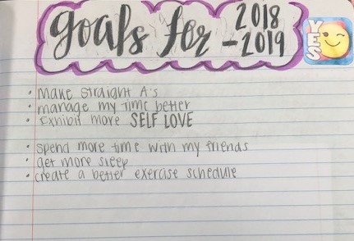
Setting up interactive journal contd. Goals Sheet Examples

Slide 11
Setting up interactive journal contd.
Left Side: Journal Expectations
Right Side: Assignment Calendar
Must be kept up-to-date
Must contain all notes and classwork assignments
Must be kept organized.
All pages must remain secured within the notebook. Use glue or tape if necessary
No ripped out pages or torn corners
Notebook should only be used in this class (No other classes)
Dates and lesson titles must be listed in the Table of Contents along with the corresponding page number
Journals must express creativity
On the top of this page you write: Table of Contents.
Using a ruler measure 1 inch from left margin. Draw a straight line vertically.
At the far right margin, draw a line directly over the pink line.
On the first line and first box write: Date Assigned
In the next box write: Assignment
In the last box write: Due Date
You will list all homework, important dates and general assignments on this page. This way you will have ready access to your weekly assignments, homework assignments and due dates.

Slide 12
Setting up interactive journal contd.
Left Side: Assignment Calendar
Right Side: Foundational Strategies Sheet
On the top of this page you write: Table of Contents.
Using a ruler measure 1 inch from left margin. Draw a straight line vertically.
At the far right margin, draw a line directly over the pink line.
On the first line and first box write: Date Assigned
In the next box write: Assignment
In the last box write: Due Date
You will list all homework, important dates and general assignments on this page. This way you will have ready access to your weekly assignments, homework assignments and due dates.
You will cut and paste the colorful sheet that you picked up last week onto this page.
Make sure it fits neatly in place.

